Slide 1
NAT Test Automation
DEMO

Slide 2
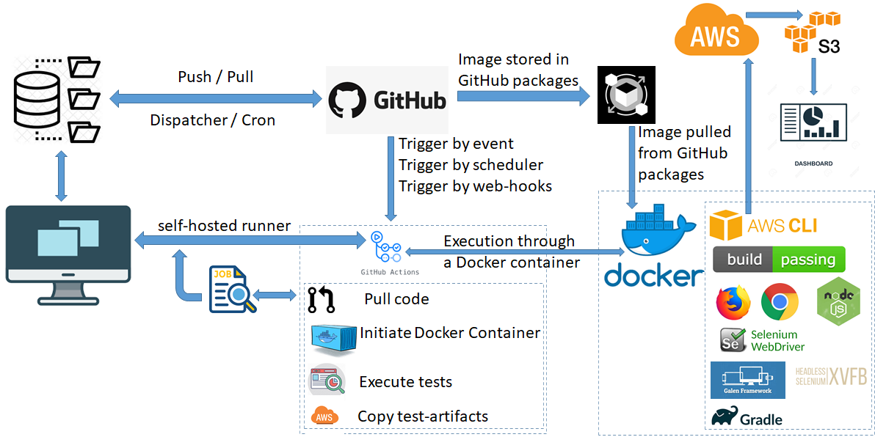
Test Automation System Architecture – Platform Services

Slide 3
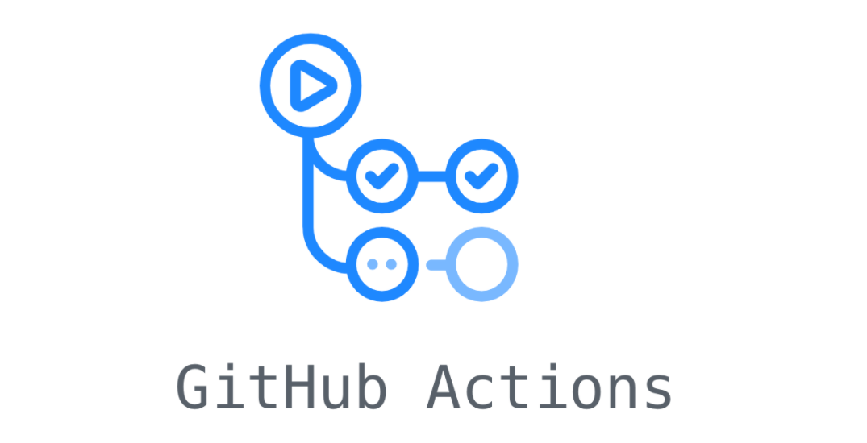











Platform Services - Technical Skills (Tools, Technologies and Frameworks)
Test Frameworks
Tools for Build Management and Development
Tools to Design Continuous Testing Model

